Slide 1
Coptic Lesson 17 Present Tense

Slide 2
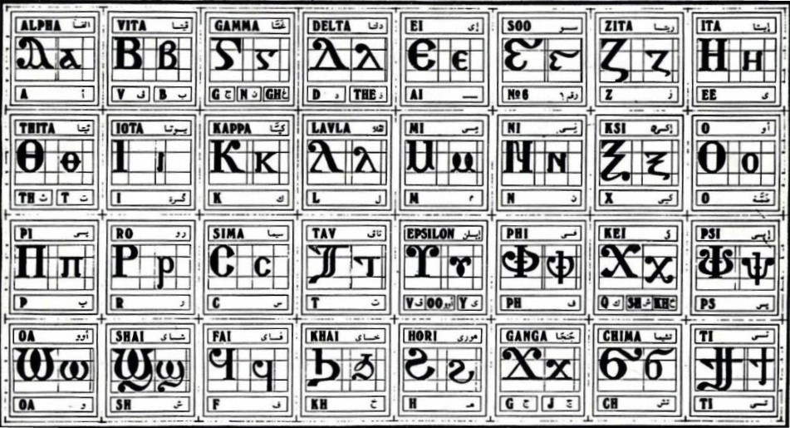
Coptic Alphabets

Slide 3
Review Questions
Coptic
Name
English
,
Kei
k, sh, kh
d
Delta
d, z
=p=r=;
Par;enoc
Virgin
=o=z
`sbe-sasf
77
=f=b
pictau-`cnau
92
q
Khai
kh
=s
'it-se
900

Slide 4
Review for Beginners
Coptic
Name
English
[
Cheema
ch
p
Pei
p
v
Phei
ph
r
Ro
r
q
Khai
kh
l
Lavla
L
d
Delta
d, z

Slide 5
Rule for the Kei <:
k
(in a Coptic Word)
< , =
sh
(Gk, before the e-family)
e-family:
e> y> i> u
kh
(Gk, otherwise)
Examples:
,ymi
,aric
,ere
`,rwm
Ar,y
Mona,oc
,w
Lu,nia
Pi,iwn
,wra
Ic,uroc

Slide 6
Vocabulary List
`areh
to study, keep
sari
to hit
]
to give
hemci
to sit
`i
to come
caji
to speak, talk
menre
to like

Slide 7
Coptic Bible Verses – Part 3
Rasi qen `P[oic `ncyou niben Rejoice in the Lord always. (Phil 4:4)
Twbh `ejen neten`eryou Pray for one another. (Jm 5:16)
Vnou] ouagapy pe God is love. (I Jn 4:16)
Jemnom] anok ai[ro `epikocmoc Be of good cheer, I have overcome the world. (Jn 16:33)
}ar,y `n]covia ]ho] `nte `P[oic te The fear of the Lord is the beginning of wisdom. (Ps 110:10)

Slide 8
Beginner Vocabulary Review
romi kahi `Vnou] `alou ioh
ry con syri iwt bal
yi ran ro ouro nyb
`chimi vorsi seri ourw ri
cwni ajp ve sau soury
mau ]`alou jij `;nyb hiomi
nicwni nirwmi niran nimau ni`alou
jom niourw nibal nisau ninyb
niseri totc io] ourwou vyou`i

Slide 9
Simple Present Tense
]caji
`kcaji
Tecaji
`fcaji
`ccaji
tencaji
tetencaji
cecaji
I speak
you speak (masculine)
you speak (feminine)
he speaks
she speaks
we speak
you speak (plural)
they speak

Slide 10
Present Tense Rule
`k ➔ `, before the letters
b l m n o r

Slide 11
Exercise (Part 1)
Use the following verbs to form a present tense:
ouwm
to eat
menre
to like
moc]
to hate
ws
to read
hemci
to sit
cw
to drink
[i
to take
nau
to look

Slide 12
Exercise (Part 2)
Translate the following into English:
]`cqai qen pikas
I write with the pen.
Pirwmi `fws `mpijwm
The man reads the book.
Tacwni `csari `e]sau
My sister hits the cat.
Pi`alou `fouwm nem tefmau
The boy eats with his mother.
Paiwt `fcw `mpi`erw]
My father drinks the milk.
Tenmoc] `mai`alou
We hate this boy.
Na`cnyou ce`areh `enouws
My brothers study their lessons.
`cws ouoh `c`cqai `nnecws
She reads and writes her lessons.

Slide 13
Announcement
All slides are available at http://www.ekladious.com/coptic.html

Slide 14
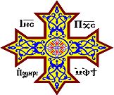
Oujai qen `P[oic

